Slide 1
UI Design

Slide 2
Time
1 week
26 Oct 2015 to 1st Nov 2015

Slide 3
Development plan
Design
Color scheme design pages, modal boxes, menu , submenu
Button and related control color schema and shape design
Home page and login page design
Dash board design for all user
Messages (Error and notification)
Menu changes is required
Forms shape and size
Table shape an size
Development
Development of above

Slide 4
Checklist
Color scheme design pages, modal boxes, menu , submenu | Done | Pending
Button and related control color schema and shape design | Done | Pending
Home page and login page design | Pending | Pending
Dash board design for all user | Pending | Pending
Messages (Error and notification) | Done | Pending
Menu changes is required | Done | Pending
Forms shape and size | Pending | Pending
Table shape an size | In progress | Pending
Task to be completed | Design | Development

Slide 5
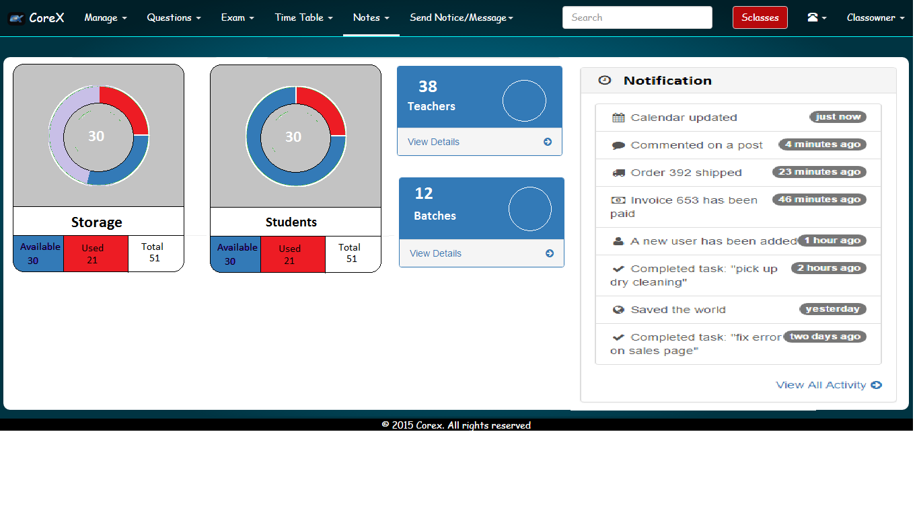
Color scheme design pages, modal boxes, menu , submenu

Slide 6
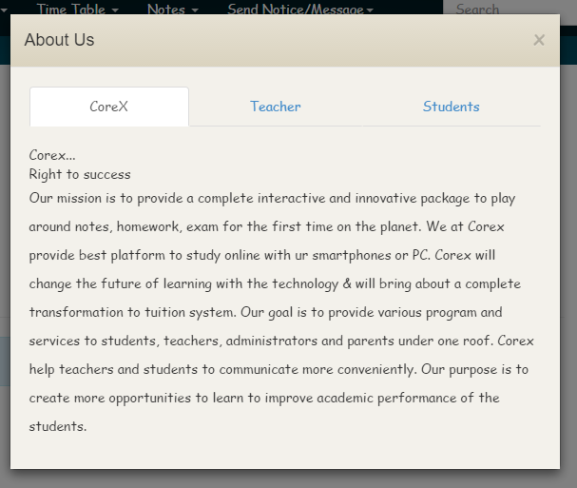

Slide 7
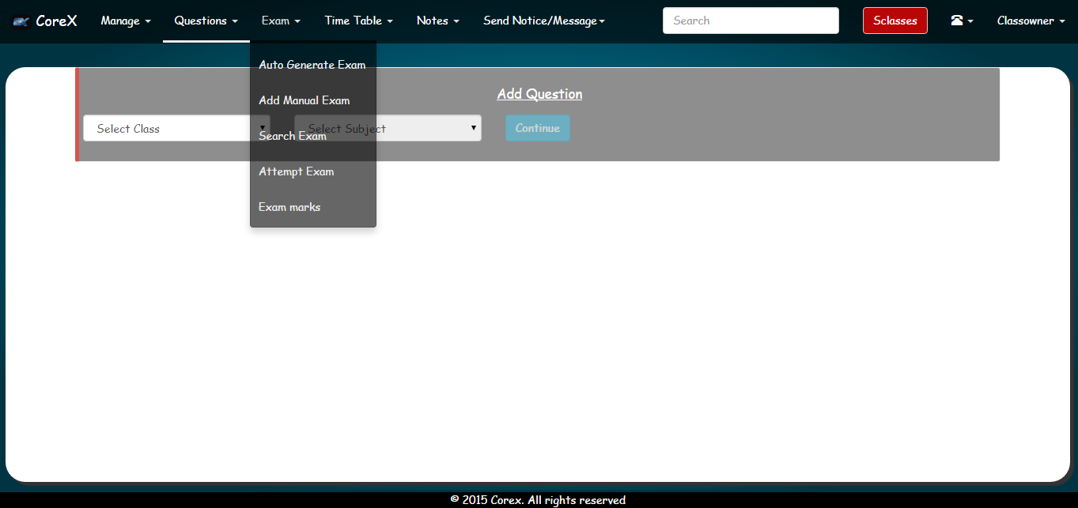

Slide 8
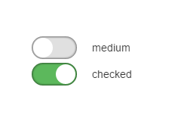
Button and related control color schema and shape design

Slide 9
Modal header
/* Permalink - use to edit and share this gradient: http://colorzilla.com/gradient-editor/#0095be+23,003442+100 */
background: #0095be; /* Old browsers */
background: -moz-linear-gradient(top, #0095be 23%, #003442 100%); /* FF3.6+ */
background: -webkit-gradient(linear, left top, left bottom, color-stop(23%,#0095be), color-stop(100%,#003442)); /* Chrome,Safari4+ */
background: -webkit-linear-gradient(top, #0095be 23%,#003442 100%); /* Chrome10+,Safari5.1+ */
background: -o-linear-gradient(top, #0095be 23%,#003442 100%); /* Opera 11.10+ */
background: -ms-linear-gradient(top, #0095be 23%,#003442 100%); /* IE10+ */
background: linear-gradient(to bottom, #0095be 23%,#003442 100%); /* W3C */
filter: progid:DXImageTransform.Microsoft.gradient( startColorstr='#0095be', endColorstr='#003442',GradientType=0 ); /* IE6-9 */

Slide 10
